Slide 1
EECE 7398 Project
Black White Anime Image Colorization
Wudi Zheng, Yaqiao Liu, Haoran Ding

Slide 2
Outline
Project Introduction
Related Works
Our Works
Performance and Analysis
Notes:
Our presentation has the following content:

Slide 3
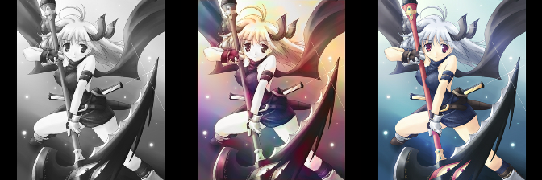
Project Introduction
Automatically coloring black white image
Grey-scale Input
Inference
Real Image
Notes:
Our presentation has the following content:

Slide 4
Related Works
Scribble-based and Reference-based approaches
Fully Automatic approaches:
CNN-based approach
Encoder-decoder approach

Slide 5
Methods based on Deep Learning
Conventional Auto-encoder
Auto-encoder with fusion layers
Our works: Residual encoder with Pyramid Pooling Module

Slide 6
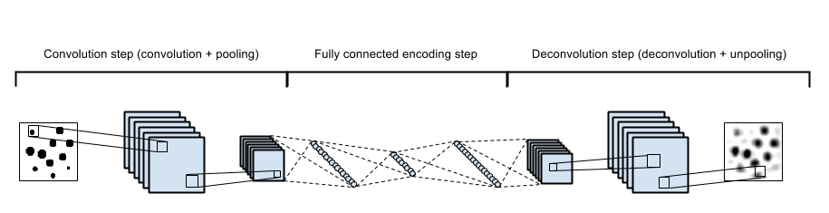
Auto-encoder method
Bad performance
Lack of image features
Vagueness of the output image

Slide 7
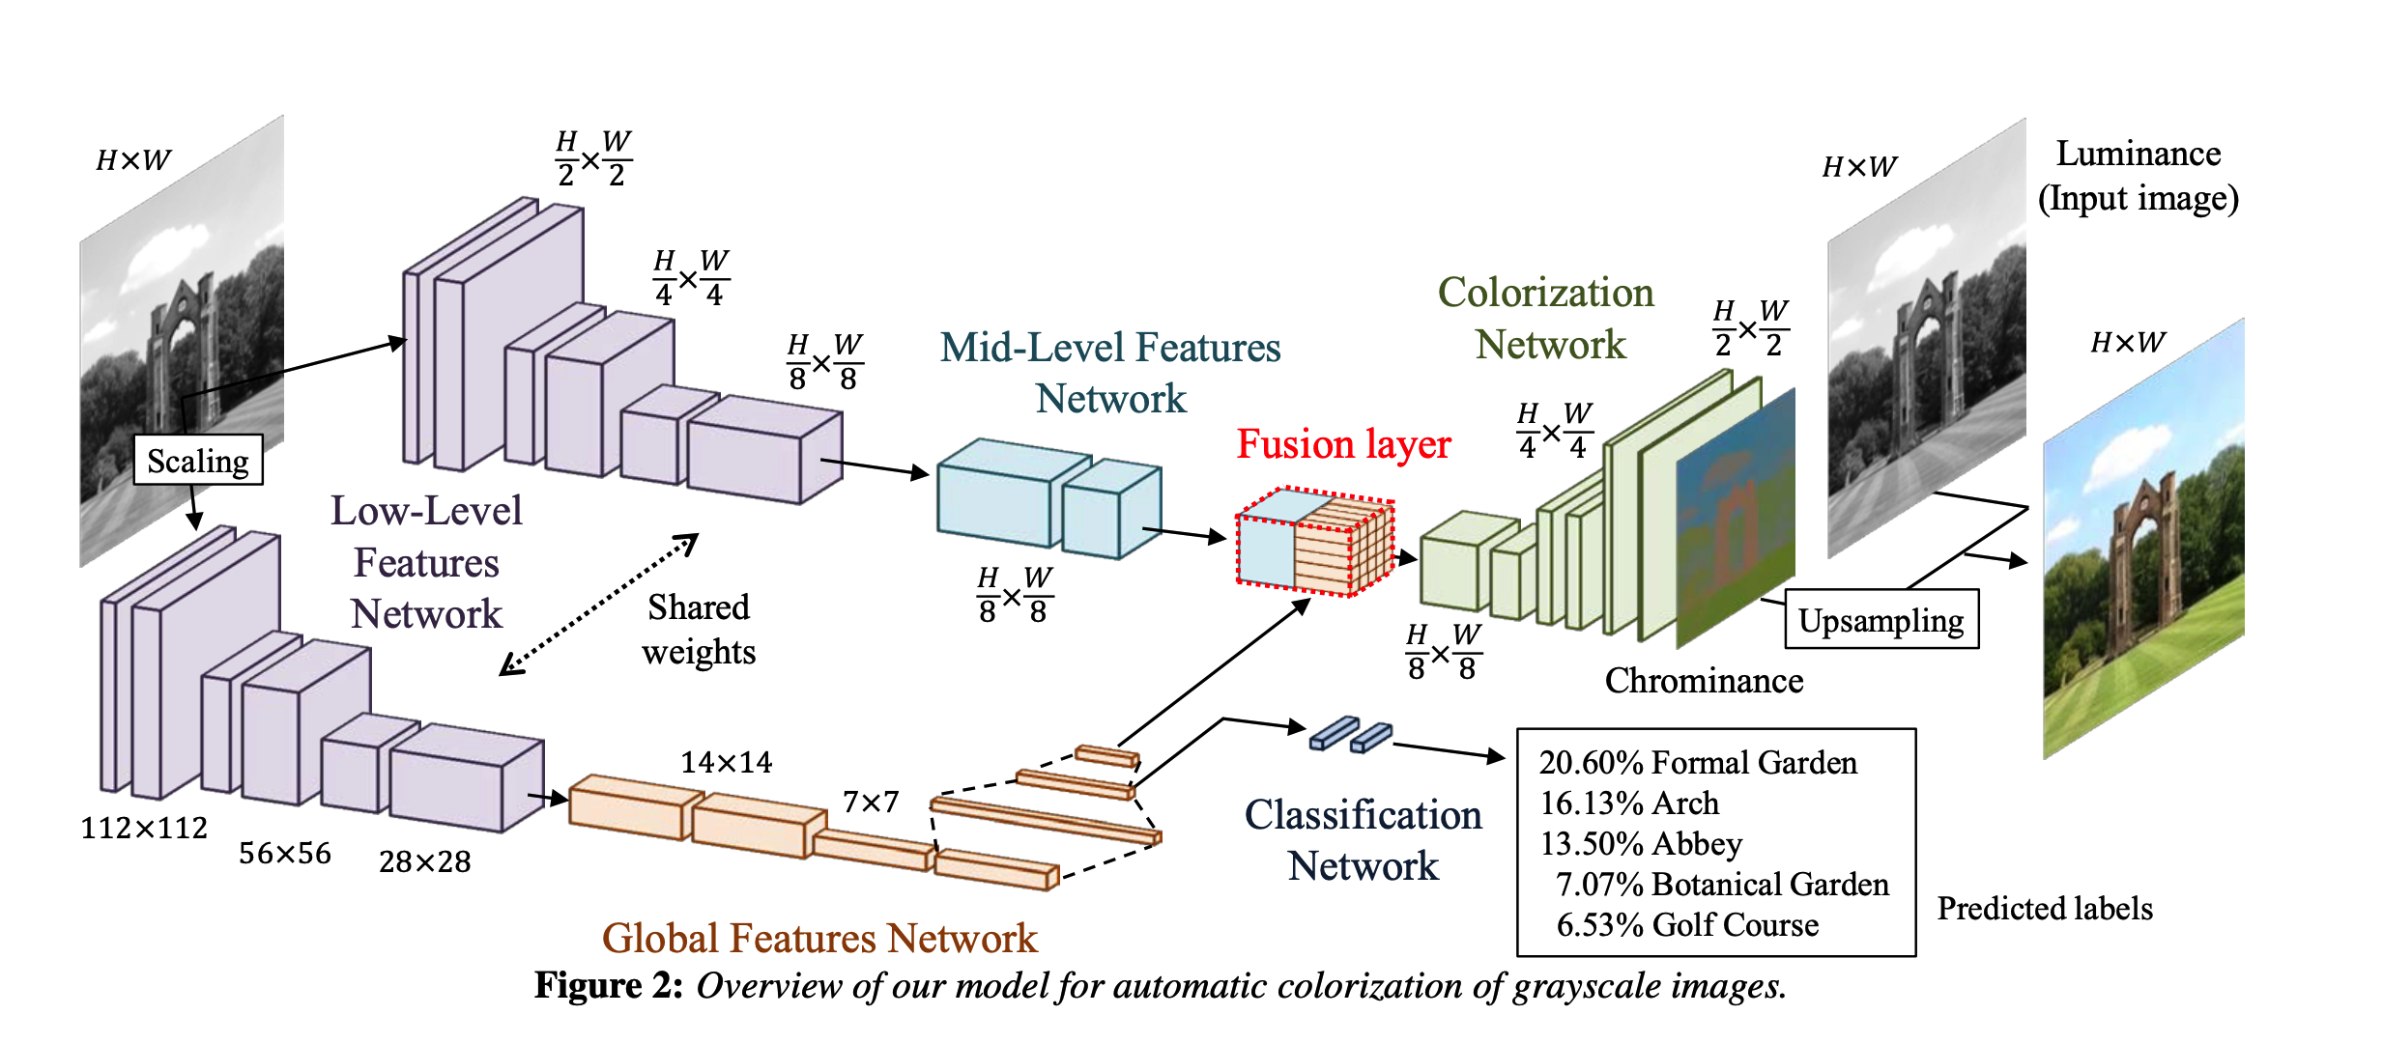
Why Fusion?
Iizuka S, Simo-Serra E, Ishikawa H. Let there be color!: joint end-to-end learning of global and local image priors for automatic image colorization with simultaneous classification[J]. ACM Transactions on Graphics (TOG), 2016, 35(4): 110.
More image features need to be added for better results.
Fusion!

Slide 8
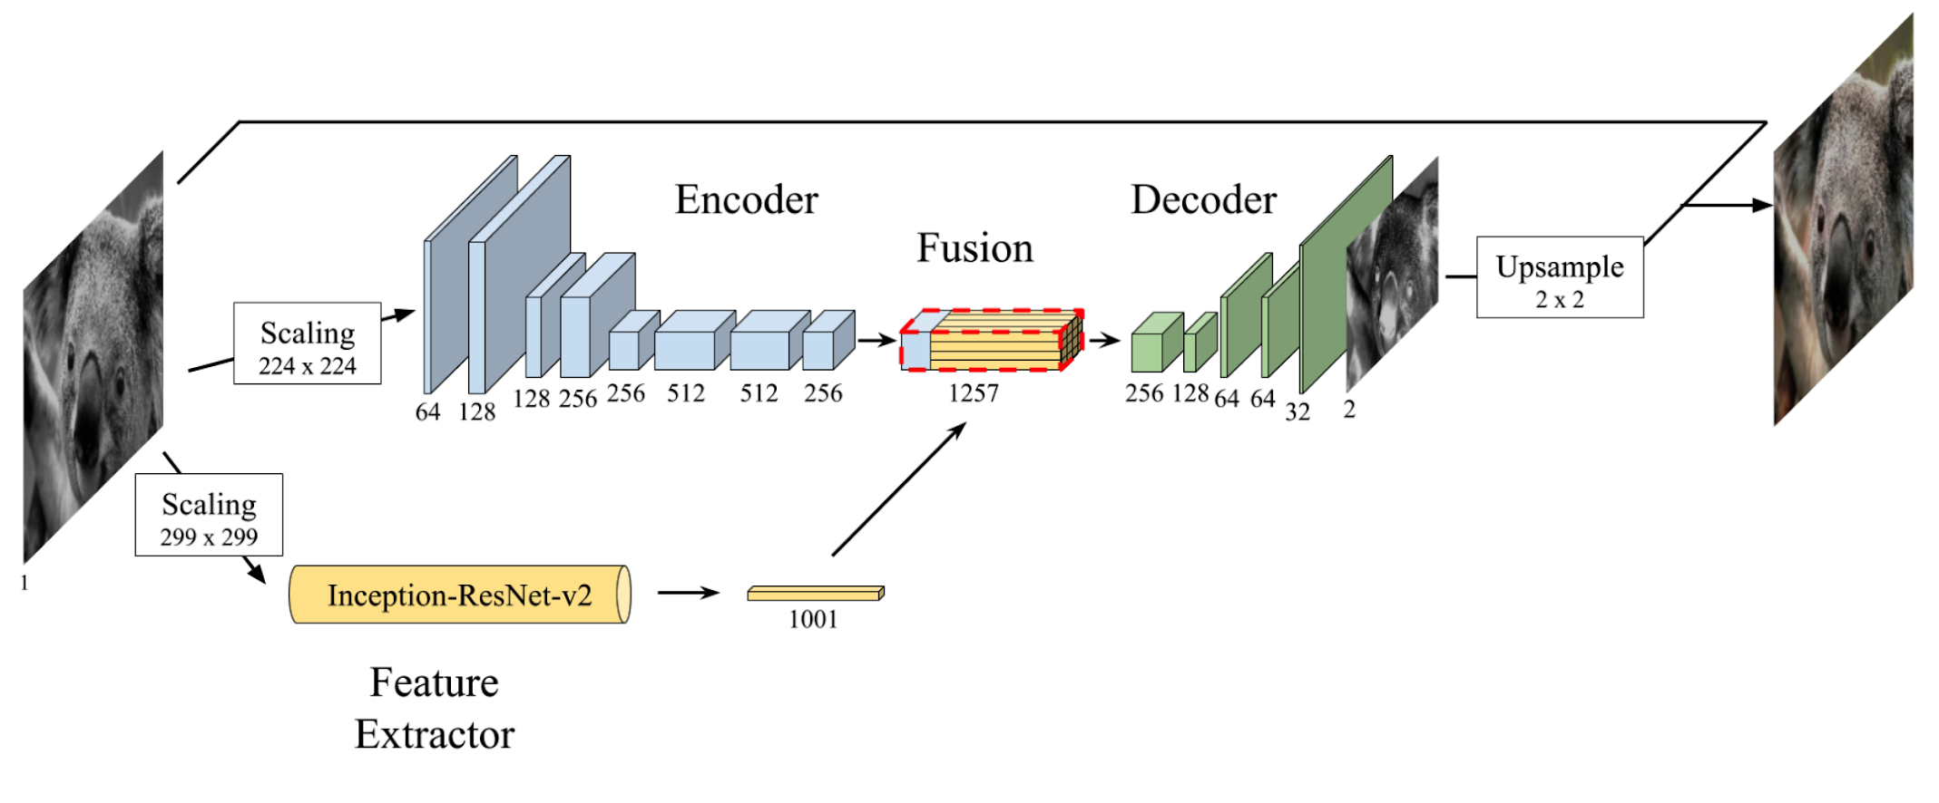
Inception ResNet with Fusion Method
Baldassarre F , Morín, Diego González, Rodés-Guirao, Lucas. Deep Koalarization: Image Colorization using CNNs and Inception-ResNet-v2[J]. 2017.
Notes:
We trained it. But the output is not as described in paper. It seems that the network only adds a cream yellow layer to the gray-scale image.

Slide 9
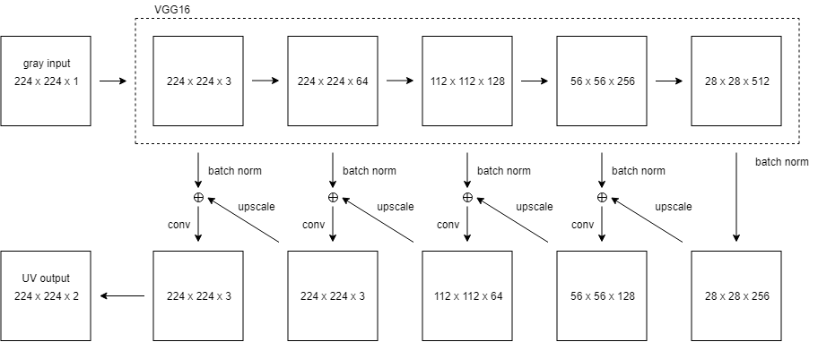
Our Model
Original Model architecture
From Chong Guo’s blog: https://tinyclouds.org/colorize/
Notes:
Easy to train and can get a descent result quickly.

Slide 10
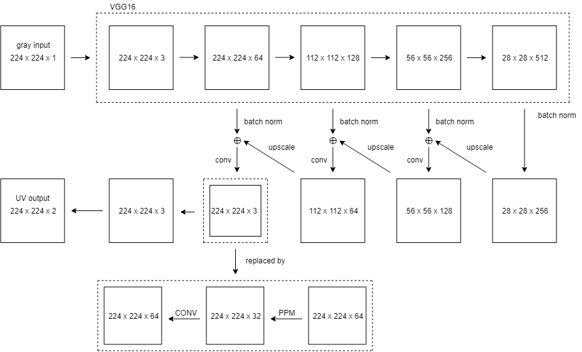
Our Model
Our Innovation Model architecture
Pyramid Pooling Module

Slide 11
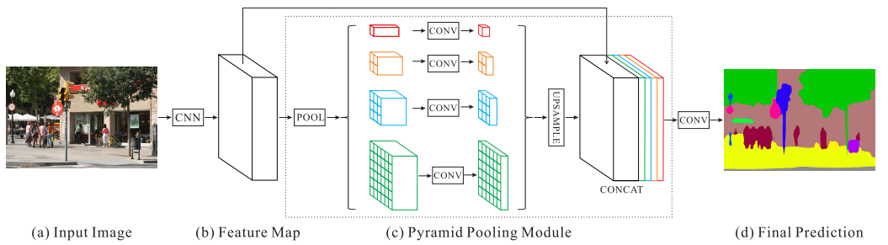
Our Model
Pyramid Pooling Module:

Slide 12
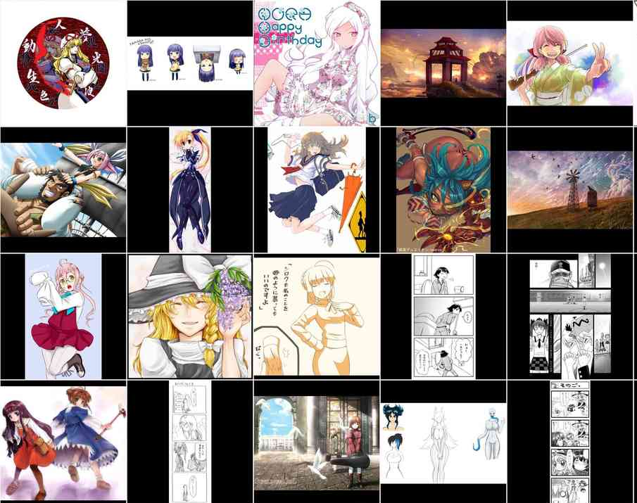
Training details
Dataset: 5K Pictures from Public Dataset Danbooru2018
(https://www.gwern.net/Danbooru2018)
Training parameters:
Optimizer: Adam
Training Time: 5 hrs
Training Epochs: 100K
Device: NVIDIA GTX 1070
and NVIDIA GTX 1050 Ti
(GPUs broke down during the training,
we lost all GPUs T_T)

Slide 13
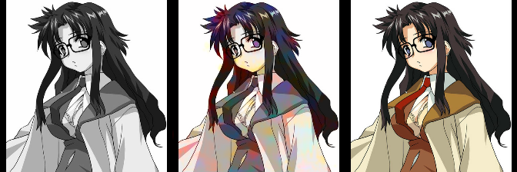
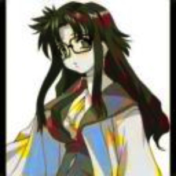
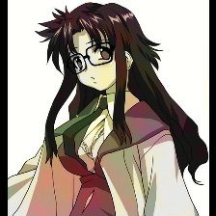
Performance
grey scale
vgg-residual
real image
auto-encoder
Methods | MSE
model with PPM | 0.007405
vgg-residual | 0.013915
auto-encoder | 0.868134
model with PPM

Slide 14
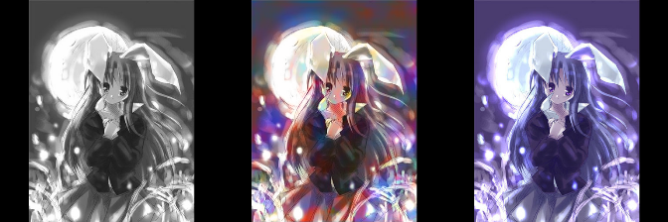
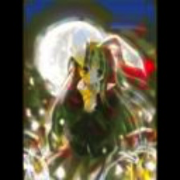
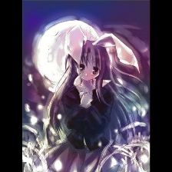
Performance
grey scale
vgg residual
real image
auto-encoder
Methods | MSE
model with PPM | 0.01475
vgg-residual | 0.03104
auto-encoder | 0.78363
model with PPM

Slide 15
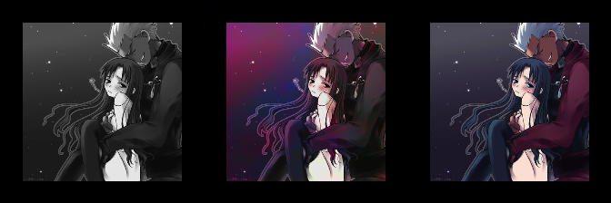
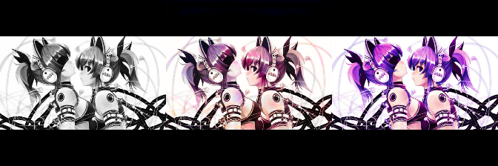
More results
grey scale
our model
real image

Slide 16
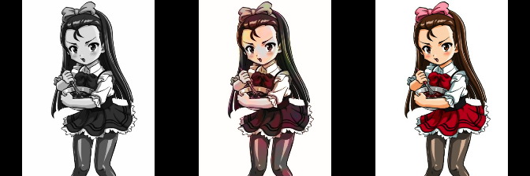
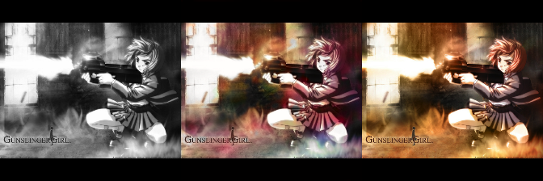
More results
grey scale
our model
real image

Slide 17
More Testing Results
We use 500 images for test:
MSE of VGG-residual is 0.02939
MSE of our model is 0.0271 -- Better!
We indeed get a better performance using this architecture.

Slide 18
In the end …
Thanks!

